Slide 1
Predicting Objectivity in Sports Articles
Group 4
Jacob Bayer, Ely Feintuch, & Nicholas Weidner

Slide 2
Research Topic
It is sometimes unclear if an article is offering facts or opinions
Articles not labeled as opinion articles can still be subjective pieces
Reading unbiased sports analysis is very important for people betting on sports
We seek to build a machine learning model that can classify sports articles as objective or subjective
Notes:
A brief description of the nature of the data, motivation and why it’s important to analyze this data. Here we should understand why the data is important, how it was collected, what is the imbalance, what is n, p, the imbalance ratio, and what are the features. (1 slide)

Slide 3
Summary Statistics
Sports Articles which have been manually classified as objective or subjective
1,000 observations with 59 variables
Variables consist of frequency measures for part of speech tags, punctuation and a few other measures
635 classified as objective and 365 are classified as subjective
Dataset is imbalanced, though not highly imbalanced with a 64:36 imbalance ratio. We have elected not to use weights.
We standardized the data and excluded two columns of no data
Source: Nadine Hajj, Yara Rizk, and Mariette Awad, 'A Subjectivity Classification Framework for Sports Articles using Cortical Algorithms for Feature Selection,' Springer Neural Computing and Applications, 2018. https://archive.ics.uci.edu/ml/datasets/Sports+articles+for+objectivity+analysis#
Notes:
A brief description of the nature of the data, motivation and why it’s important to analyze this data. Here we should understand why the data is important, how it was collected, what is the imbalance, what is n, p, the imbalance ratio, and what are the features. (1 slide)

Slide 4
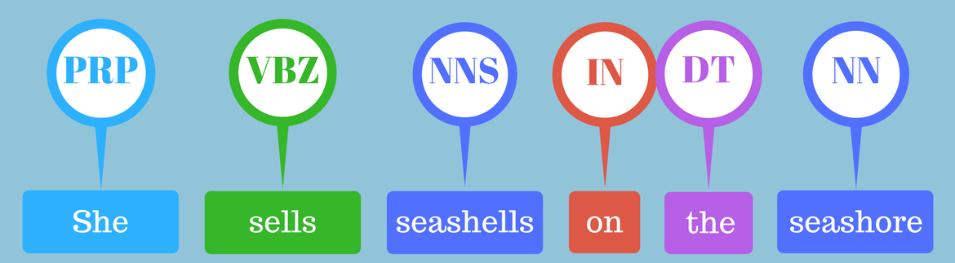
Part of speech (POS) tagging

Slide 5
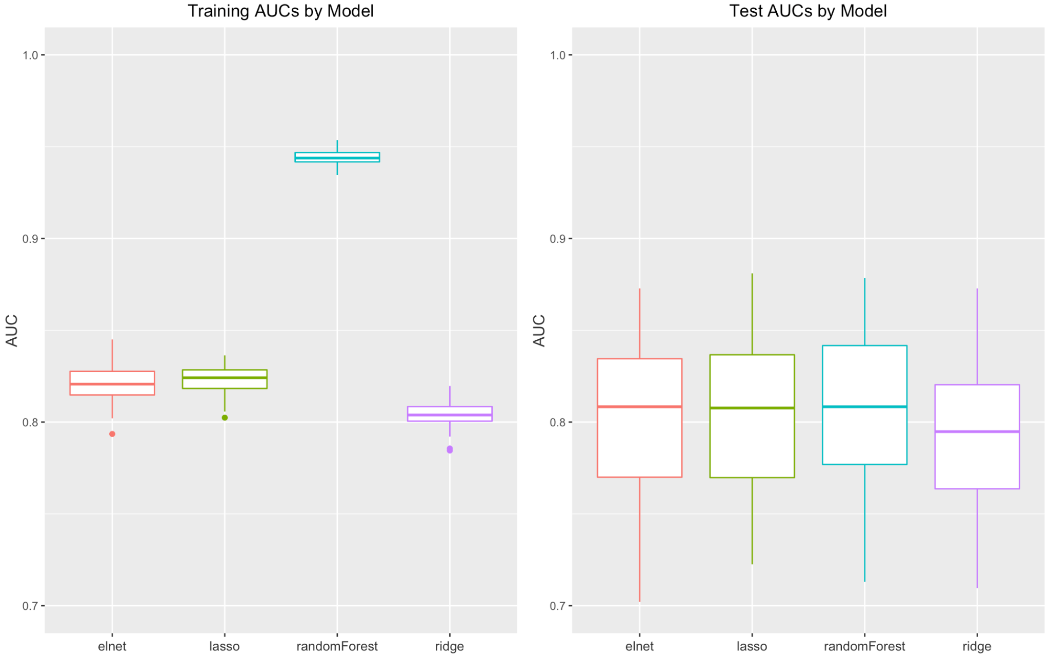
Notes:
Boxplots of the 50 AUCs (train and test) for ntrain = 0.9n. Specifically show two plots, one for test AUCs and train AUCs, respectively. Make sure everything is clearly visible and legible. (1 slide)

Slide 6
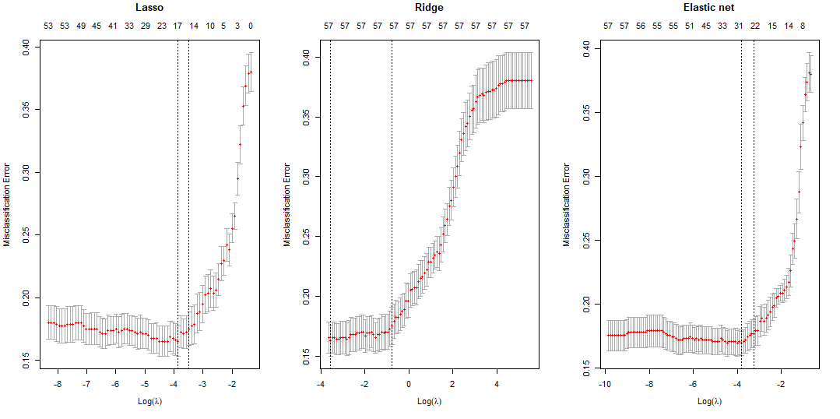

10-Fold Cross Validation Curves
Notes:
For one on the 50 samples, create 10-fold CV curves for lasso, ridge and elasticnet. Record the time it takes to cross-validate ridge/lasso/elastic-net logistic regression. (1 slide)

Slide 7
Median Test AUC and Time Elapsed
 | Median Test AUCs | Mean Training Time
Elastic Net | 0.8008443 | 4.4126160 secs
Lasso | 0.7976899 | 5.5528463 secs
Random Forest | 0.8225601 | 1.1338467 secs
Ridge | 0.8001260 | 0.7050178 secs
There is no trade-off evident in time versus model performance
Notes:
Also record the time it takes to fit a single ridge/lasso/elastic-net logistic regression (including the time needed to perform cross-validation parameter tuning), and random forrest. Create a table 4 × 2 table, the 4 rows corresponding to the 4 methods, and the two columns for test AUCs and time. Specifically, the first column should show the median of test AUCs among the the 50 samples, and the second column the time it takes to fit the model on all the data (as described in the sentences above). Is there a trade-off between the time it takes to train a model and it’s predictive performance? (1 slide).

Slide 8
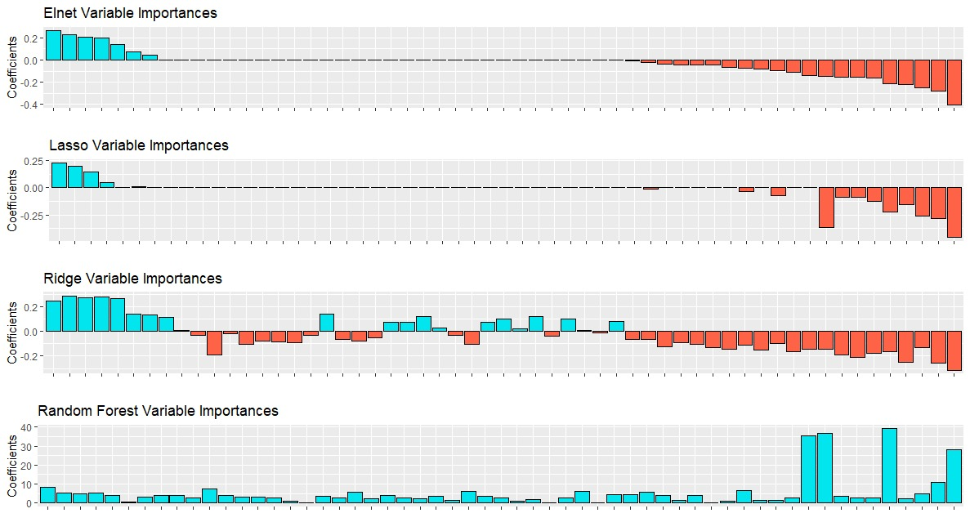
Parameter Importance
Quotes
CC
past
VB
PDT
sent1st
NN
RP
totalWords
smnticobjscr
CD
EX
FW
INs
JJ
JJR
JJS
MD
NNPS
POS
PRP
RBS
SYM
VBD
VBG
WP
baseform
fullstops
commas
semicolon
colon
ellipsis
pronouns1st
pronouns2nd
sentencelast
txtcomplexity
prsnt1st2nd
VBN
smntcsubjscr
RBR
UH
TOs
RB
imperative
VBZ
NNS
pronouns3rd
present3rd
VBP
WP.
exclamarks
DT
LS
WDT
compsadjadv
qstnmarks
PRP.

Slide 9
Conclusions
All models developed would be suitable for identifying Objectivity of sports articles
Random Forest provides the best balance of time to compute and maximization of AUC
Further analysis could look into if the model can be expanded to other genres of articles - political, local reporting, weather etc.
The full R code for this project can be found at: https://github.com/jacob-bayer/STA9891-Final-Project

